Slide 1



DEESHA
Diabetes (Type 1) Education and Empowerment Strategic Health Alliance
(Action Group for Type 1 Diabetes Mellitus Children in India)
The Alliance is an informal, apolitical, interest group of stakeholders.

Slide 2

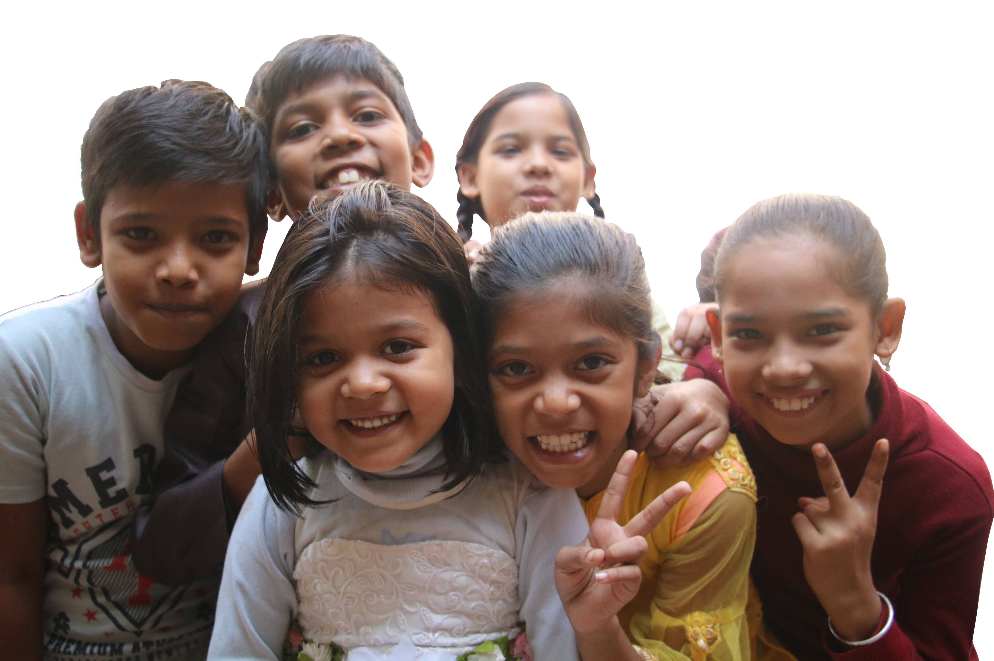
Context
People to People Health Foundation (PPHF) convened a series of 3 meetings of stakeholders on “Working together to increase financing for Type 1 Diabetes Mellitus children in India” starting between July to October 2023.
The stakeholders expressed their common consensus on the following:
There is a need to advocate for improved policies, strategies, and operating systems for improved financing for T1D children.
Collectively work in developing a national plan with stakeholders including the government for equitable coverage, outcomes, and resource allocations for T1D children.
Create a multi-stakeholder platform of diverse organizations and work as a task force on key issues to deliver products/strategies (short, medium, and long-term) for the stakeholders.

Slide 3
Purpose of DEESHA
Raising awareness, foster collaboration, and advocate for improved programs on diabetes with a special focus on T1D
Serves as a unique platform for bringing together key stakeholders to advocate for improved policies, programs and increased financing for sustain support on T1D
National observatory of issues and best practices
Providing policy and program recommendations and developing position papers based on contemporary evidence
Provide a platform to showcase effective interventions for scaling
Partner for increased collaboration and leverage private sector good practices
Support and supplement government initiatives
Act as an advisory body on DM related technical and other issues to Government and other institutions
Promote coordination among ministries, development partners, private sector and other NGOs, international and UN agencies responsible for implementing T1D program
Knowledge Management- Provide required tools for program advocacy, implementation and monitoring

Slide 4
High Priority Activities
Short Term | Short-term
6 months | A. 6 months
1. | Establish a secretariat of DEESHA. | Establish a secretariat of DEESHA.
2. | Develop strategy for DEESHA (operating model, action groups, membership). | Develop strategy for DEESHA (operating model, action groups and membership).
3. | Formation of action groups on themes or subthemes (e.g., financing, livelihood models, access to medicine, supply chain etc.) | Formation of action groups on themes or subthemes (financing, insurance, livelihood models, awareness and education, access to medicine, supply chain)
4. | Support action groups and meetings and assist in the implementation of action group activities. | Support action groups and meetings and assist in the implementation of action group activities.
6-12 months | B. 6-12 months
5. | Develop knowledge products, publications, position papers. technical briefs, communication, and other resource material.
6. | Organize an annual conference on critical topics of importance to the national program and policy stakeholders.
7. | Active participation in govt. forums, meetings and other engagements would be an integral part of advocacy efforts to ensure the achievement of desired objectives.

Slide 5
Medium and Long Term
Medium Term (12-36 months)
Bring Type 1 DM into the public and political domain.
Higher budgetary allocation for Type 1 DM interventions.
Increasing access to affordable and quality medication for Type 1 DM.
Increase community awareness and access to related services.
Improve supply chain for sustainable access to Type 1 DM medicines and availability of diagnostics.
Improve Health Management Information System to have better epidemiological data on Type 1 DM for better programming.
DEESHA will have a mandate for influencing all relevant stakeholders in driving successful T1D outcomes.
Long Term (3-5 years)
Opportunities for establishing and improving legislations, policies and implementation practices.
Regularly conduct events, seminars and conferences serving as a platform for networking, best practice sharing and knowledge exchange amongst members.
Provide opportunities for members to voice their concerns.
Facilitate design and maintenance of a KM portal and ensure effective capturing, archiving and sharing of knowledge from multiple sources with members through the portal.

Slide 6
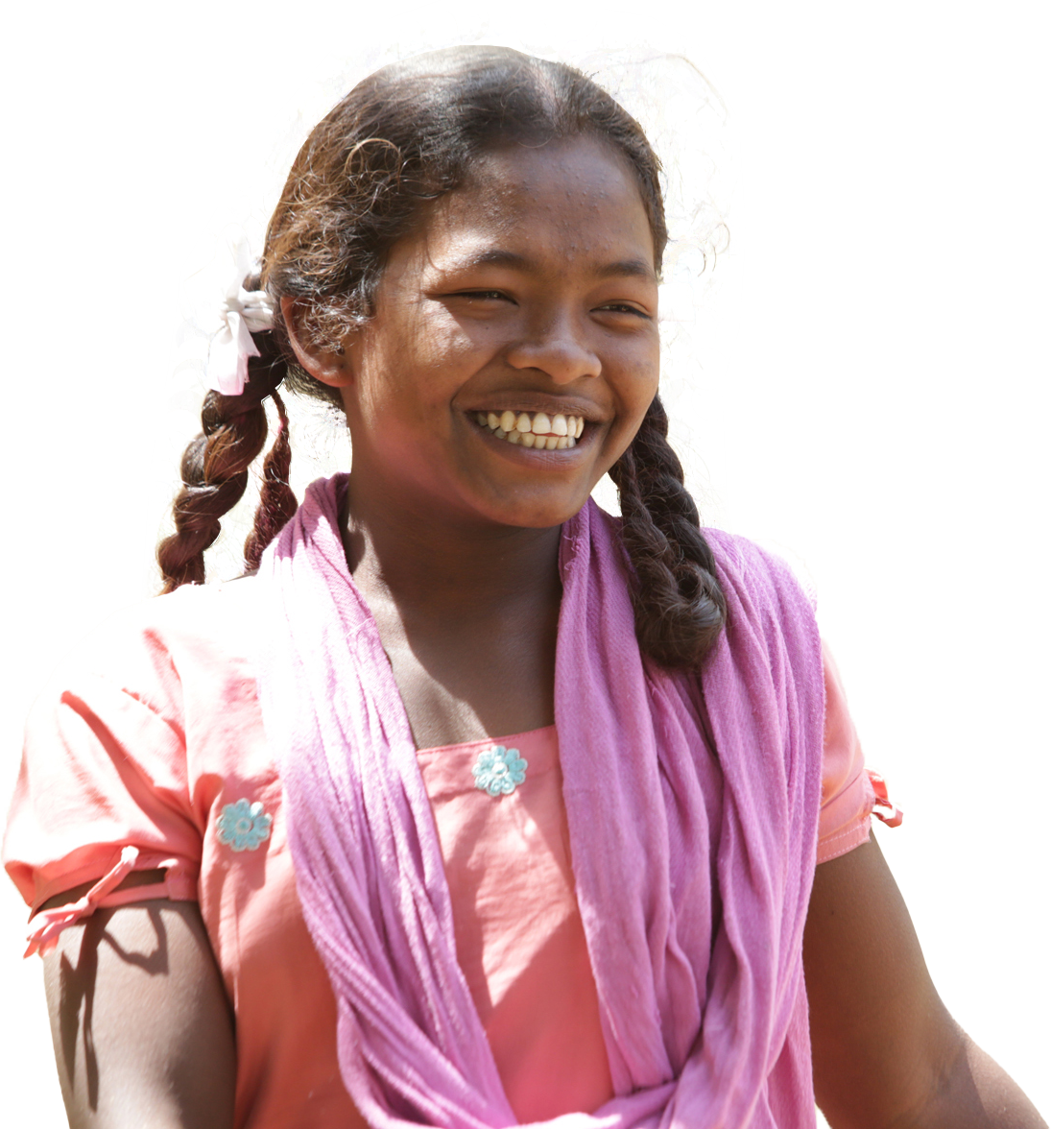
Operating Model- Composition and Functions of DEESHA
Structure |  | Composition |  | Key Functions
Action Groups |  | Smaller groups of 5-6 key experts and members on different sub-themes such as financing, insurance, livelihood models, awareness and education, access to medicine, and supply chain. Having 1-2 facilitators. |  | Work as Action Groups on key issues and sub-themes and delivers products/strategies etc. for DEESHA members.
DEESHA Secretariat |  | The Secretariat will be responsible for providing administrative and content support to action groups and facilitating services to members. |  | Secretariat will be responsible for regular day-to-day decision making in running the DEESHA activities
DEESHA Apex Advisory Committee |  | 5-7 members representative of action groups and/or other independent members. |  | Apex body responsible for all strategic decision-making. The apex decision-making body for all workplan activities and Scope of Work. All time-sensitive, critical decisions and conflict resolution in case of no consensus.

Slide 7
Role of DEESHA Secretariat
1
2
3
4
Maintain files and essential documents
Support action/working group
Provide document preparation services
Hire and support consultants for specialized assignments, as requested
5
6
7
Contribute to strategic and administrative planning
Contribute to technical and advocacy initiatives and events
Provide logistic support to members

Slide 8
Stakeholder’s Meeting Minutes
First Stakeholder’s Meet on Increasing Financing for Type 1 Diabetes Mellitus Children in India: https://pphfglobal.org/wp-content/uploads/2023/08/Meeting-brief_Increasing-financing-for-Type-1-Children.pdf
Second Stakeholder’s Meet on Increasing Financing for Type 1 Diabetes Mellitus Children in India: https://pphfglobal.org/wp-content/uploads/2023/10/Meeting-minutes-from-second-task-force-group-meeting-for-Type-1-Diabetes-Final.pdf
Third Stakeholder’s Meet on Increasing Financing for Type 1 Diabetes Mellitus Children in India: https://pphfglobal.org/wp-content/uploads/2023/10/Meeting-minutes-of-third-task-force-group-meeting-for-Type-1-Diabetes.pdf

Slide 9

People to People Health Foundation
K-40, Third floor, Jangpura Extension, New Delhi 110014
Phone: 011-35121441 | Mobile: +91 98719 50708
E-mail: deesha.secretariat@pphfglobal.org | Website: www.pphfglobal.org

